Slide 1
Copy Move Forgery Detection by Efficient Key-Point Based Method using Hybrid Feature Extraction
Presented by: Hamad (L1F19MSCS0020)
Supervisor: dr. amjad iqbal

Slide 2
Outline
Introduction.
Literature Review.
Challenges.
Research Gap.
Methodology.
Dataset.
Conclusion
References

Slide 3
introduction
What is Image Forgery
Manipulation of image.
To hide the important or useful information.
Hard to detect.
Different tools for forgery.
Post image processing techniques.
Types of Forgery Technique
Primary technique.
Copy-Move Forgery vs Splicing Forgery.

Slide 4
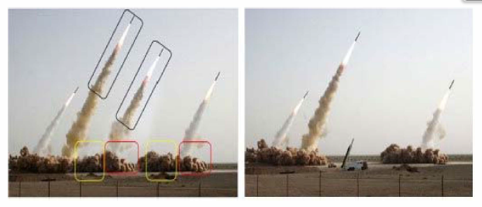
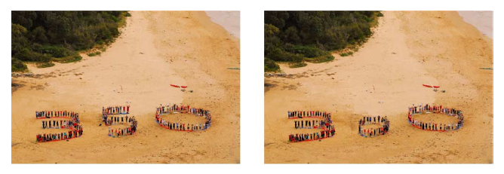
Introduction cont..
What is Copy-Move Forgery?
Part of image is copied and pasted in same image.
Have same comparable features.
To hide important information
Why detection is important?
Technology dependent era.
Easy to use technology.
Social media platforms are increased.

Slide 5
Introduction cont..
Multi-media impacts our society norms and culture.
Images play important role in detection of crime.
Images are main source of information.
It is used for research study.
Free online tools on internet.

Slide 6
Literature review
References | Dataset | Methodology/framework | Accuracy | Shortcomings
Aaditya R. Hambarde | Dataset MICC-F220 | Discrete Wavelength Transform (DWT), SIFT | 92% approximately | Not much robust and the computational cost is very high
Akash Kumar | COCO (Lin et al. 2014), CASIA V2 (Dong, Wang, and Tan 2013) | Domain Adaption Neural Network (DANN), Build dataset of forger images | 78.8% approximately | Less dataset to train the algorithm on and not highly accurate
Sunitha K, Krishna A N | Dataset MICC-F220 | Key-point extraction, SIFT | 92.5% approximately | Less accurate, high false positive value with not good f1 score,
Fang yan, Wei Lu, Jian Weng | benchmarking dataset created by Christlein et al. (2012). | Scale Invariant Feature Transform (SIFT), KAZE, Hybrid Feature Extraction | 98% approximately | Not applicable to detect the changes if the image is rotated or moved

Slide 7
Literature review cont..
References | Datasets | Methodology/framework | Accuracy | Shortcomings
IreneAmerini, LambertoBallan, RobertoCaldelli | MICC-F2000 [6], SATS-130 [24], MICC-F600. | J-linkage Algorithm, SIFT, state-of-the-art-technique | 89.47% approximately | Does not detect all the key-points and system have low accuracy.
HWEI-JEN LIN, CHUN-WEI WANG and YANG-TA KAO2 | 50 images is been cropped from original and 150 tempered images | Radix sort, Single value degradation (SVD), Connected component Analysis | 98% approximately | It is robust but didn’t detect all copied region. Does not deal with the rotation problem.

Slide 8
Challenges
Maximum accuracy of the system in detection of forgery.
Robust system.

Slide 9
Research GAp
The robustness of the system is still an issue these days.
Multiple researchers have try to gain optimum accuracy but still there is room for betterment.
The detection of copy-move forgery is yet to be research on the smooth, symmetrical, and recurring region.
Make the model robust adversarial attacks.

Slide 10
Aims & objectives
To increase the accuracy of the existing system.
Make the system more robust against adversarial attacks.
We will try to detects the forgery on the smooth, symmetrical and recurring area.

Slide 11
methodology
Agglomerative Hierarchical Clustering
Divide the image into equal parts
SURF
Key-Point Detection
SIFT
Key-point Extraction
Real Image
Outline Remove and transformation elimination
Eliminate Mismatches
Output Image
RANSAC

Slide 12
Dataset
MICC-F220
MICC-F220: this dataset is composed by 220 images; 110 are tampered and 110 originals.
CASIA V2 (Dong, Wang, and Tan 2013)
It contains 4975 images (Authentic - 1701, Forged - 3274).

Slide 13
CONCLUSION
Images are till the best way to get information.
They are very helpful to fight against the crimes.
Image forgery is easy to do and very hard to find by naked eye.
Copy-move forgery is well known and common type of forgery.
Still the work has to be done to achieve maximum accuracy.
We will try to detect forgery on symmetric, smooth and recurring area.

Slide 14
references
[1] Y. Ke, Q. Zhang, W. Min, and S. Zhang, “Detecting Image Forgery Based on Noise Estimation,”, vol. 9, no. 1, pp. 325–336, 2014
[2] Shivakumar. B. and Baboo.S, “Detection of RegionDuplication Forgery in Digital Images Using SURF,”International Journal of Computer Science Issues , vol. 8, no.4, pp. 199–205, 2011.
[3] J. Fan, T. Chen, and J. Cao, “Image tampering detection using noise histogram features,” International. Conference on Digit. Signal Process DSP, vol. 2015-September, pp. 1044–1048, 2015.
[4] J. Zhao and W. Zhao, “Passive Forensics for Region Duplication Image Forgery Based on Harris Feature Pointsand Local Binary Patterns,” Mathematical. Problems in Engineering, vol. 2013, pp. 1–12, 2013.
[5] S. Farooq, M. H. Yousaf, and F. Hussain, “A generic passive image forgery detection scheme using local binary pattern with rich models,” Computer and Electrical Engineering, vol. 62, pp. 459–472, 2017
[6] R. Dixit, R. Naskar and S. Mishra,.”Blur-invariant copymove forgery detection technique with improved detection accuracy utilising SSVD”, in IET Image Processing, vol. 11, no. 5, pp. 301-309, 2017.
[7] Zandi, M.; Mahmoudi-Aznaveh, A.; Talebpour, A. “Iterative copy-move forgery detection based on a new interest point
detector”. IEEE Transactions on Information Forensics & Security. 11, 2499–2512, 2016.
[8] X. Wang, G. He, C. Tang, Y. Han, and S. Wang, “Keypoints-Based Image Passive Forensics Method for Copy-Move Attacks,” International Journal of Pattern Recognition and Artificial Intelligence, vol. 30, no. 3, 2016.
[9] G. Ulutas and G. Muzaffer, “A New Copy Move Forgery Detection Method Resistant to Object Removal with Uniform Background Forgery,” Mathematical. Problems in. Engineering, vol. 2016.
[10] Yang, B.; Sun, X.; Guo, H.; Xia, Z.; Chen, X. “A copy-move forgery detection method based on CMFD-SIFT”. Multimedia Tools Applications 77,pp. 837–855, 2018.

Slide 15
THANK YOU!

